Slide 1

Understanding VistA’s Architecture
March 29, 2010
VA Internal Use Only

Slide 2
Session Outline
History of VistA
  Orient group to how VistA emerged and how it is governed
Class III->Class I and Innovations Programs
Considerations for how to approach HealtheVet
Questions

Slide 3
What is VistA and why do we care?
Source of information & work flow management for patient care & health care operations
  Care management, facility management, ad hoc queries
  250,000 users across VA
Service-based suite of applications
  Supported by a common suite of infrastructure utilities & services with a well-managed, integrated database, according to documented standards and governance
Defines the existing IT universe for VHA for functions and performance for over 95% of VHA business functions

Slide 4
Early Development/ VistA’s Foundation
Began as “underground” effort by volunteers
Sanctioned as the Decentralized Hospital Computer Program (DHCP) in February 1982
First set was called Core – A/D/T, Scheduling, Outpatient Pharmacy and Lab
Then came Core Plus 4 followed by Core +8 and so on…, each defining proscribed functional growth
Throughout this growth, VistA was governed and guided by development standards
  Programming Standards and Conventions – defines allowed M and Delphi constructs
  Database Administration Program – defines/governs all aspects of the VistA database
  Integration Control Registry – reviews/approves/documents all services and their use

Slide 5
VistA’s Common Services
Throughout this growth, VistA continued to evolve its software infrastructure (today the term used is Common Services), specifically:
  Kernel – provides security, user management, task management, isolation/independence from underlying OS and M versions
  VA FileMan – provides database management system
  Remote Procedure Call (RPC) Broker – provides secure access to data for client/server and other remote services, invoking application and Kernel-based RPCs
  HL7 – provides robust HL7 message structuring and controls, including interface to Interface Engine
  Kernel Toolkit – provides developer toolkit including deployment toolkit (Kernel Installation and Distribution System (KIDS)

Slide 6
VistA’s Evolution beyond single-facility system
As VistA matured, applications created APIs and RPCs to facilitate encapsulated access to data and services – this established the framework for client/server and inter-system data exchange
  Computerized Patient Record System (CPRS)
  BHIE/FHIE
  Remote Data Interchange (RDI)
  VistAWeb and MDWS
In 1997, CPRS GUI was introduced, advancing VistA to a client/server (2-tier) architecture
Today, there are 125 distinct software products in VistA
  To date, only a small set of small number of applications have been rehosted as HeV solutions (e.g., Voluntary Service, Patient Advocate System Veterans Personal Finance System, Blind Rehabilitation and Blood Bank (VBECS))

Slide 7
What does current VistA imply for the future?
VistA establishes the “low bar” which must minimally met as it matures/evolves
  Response time – must be good as or better than VistA
    Opening the chart for a new patient: < 3 seconds
    Changing to a different tab: < 1 second
    Other operations, like clicking a list in an ordering dialog: <500ms
  No user functionality is abandoned unless approved by the user community
    Where functionality impacts multiple groups, all must concur
  Extensibility is supported
    Field development is allowed so long as national capabilities are not disrupted
    VistA allows/supports/promotes extensibility
  VA business partners (e.g., IHS) are supported

Slide 8
Why did VA Build Kernel and VA FileMan?
Native M environment is “unformed”
VA needed framework to allow multiple teams to build VistA by separate teams in geographically different locations and successfully integrate solutions
VA needed an environment that would allow VA to introduce new versions of M and Operating Systems without the need to rewrite applications – vendor independence!

Slide 9
More about the Kernel
Kernel provides a full environment for VistA:
  Abstraction layer to isolate VistA from dependencies on specific M and/or operating system implementations
    Example – %ZIS Utility to manage devices
  Security framework
    User authentication
    Role-based security
    Electronic Signature
  Developer’s workbench
    XINDEX – to check for compliance to standards
    Support for editors
  Operational controls
    TaskMan – to schedule/manage background tasks

Slide 10
More about VA FileMan
VA FileMan provides a full database management system environment for VistA:
  Definition of data dictionaries, including data attributes
  Security controls
    Access at file and data level
  Developer’s workbench
    Tools to ensure data matches data dictionary
    Array of indexing methods for performance
  Data Search, Sort, Print Tools
    Ability to define structured reports within applications
    Ability for ad hoc reporting
    Ability to export Search results to external formats (e.g., Excel)
    Ability to map to SQL databases

Slide 11


The “Egg” – a depiction of VistA
VISTA SOFTWARE PACKAGES
VistA
IMAGING
MEDICAL
RECORDS
TRAINING
VOLUNTARY
SERVICE
REHAB
MEDICINE
ACCOUNTS
RECEIVABLE
ENROLLMENT
ADMISSION
DISCHARGE
TRANSFER
LIBRARY
PATIENT
FUNDS
INTEGRATED DATABASE
NURSING
LABORATORY
PATIENTS
PERSONS
RADIOLOGY
COMPUTERIZED
PATIENT
RECORD
SYSTEM
(CPRS GUI)
DENTAL
RPC
BROKER
DRUGS
BLOOD
BANK
PROBLEM
LIST
MAILMAN
SURGERY
WARDS
TASK
MANAGER
SOCIAL
WORK
KERNEL
MANAGER
BAR CODE
MEDICATION
ADMINISTRATION
MENU
MANAGER
SPINAL CORD
INJURY
SECURITY
LAB
RESULTS
VA
FILEMAN
MENTAL
HEALTH
MEDICINE
PRESCRIPTIONS
TEXT
INTEGRATION
UTILITIES (TIU)
INVENTORY
WOMEN’S
HEALTH
ENGINEERING
IMAGES
BLIND
REHAB
ONCOLOGY
SCHEDULING
MEDICAL
CARE
COST
RECOVERY
DIETETICS
HEALTH
SUMMARY
AUTHORIZATION
SUBSCRIPTION
UTILITY (ASU)
INTEGRATED
FUNDS
CONTROL
ACCOUNTING &
PROCUREMENT
INPATIENT
PHARMACY
OUTPATIENT
PHARMACY
CLINICAL
REMINDERS
CONSULT /
RESULT TRACKING
VA Internal Purposes Only

Slide 12
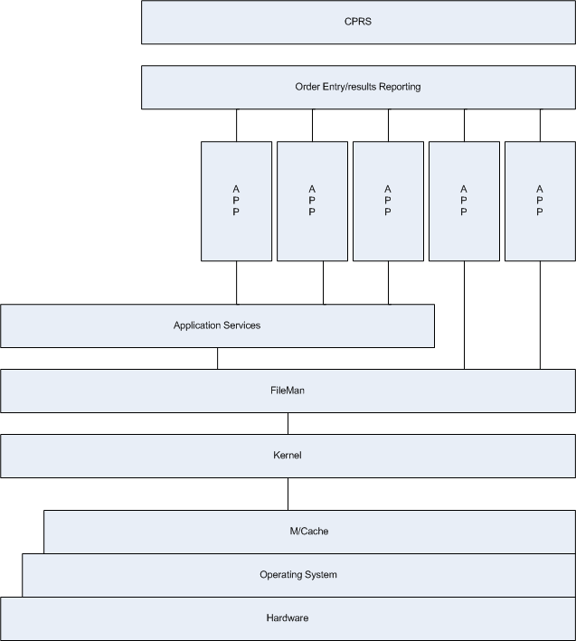
VistA – Basic Structure
VistA
Written in M and Delphi
Mediated messaging based on APIs, RPCs and other structured protocols
All database components, APIs, RPC, HL7 messages, tec. documented in library
Refereed by authoritative DBA and Standards Committees

Slide 13
VistA Governance
Programming Standards – define rules and conventions
Database Standards – defines subdivision of the files (within VA FileMan)
  Consists of Namespaces – 2-4 character sets that all code, option names, etc. within an application must begin with (e.g., Outpatient Pharmacy is PSO, Registration is DG, etc.); note that each VAMC and VISN also has proscribed set of namespaces; many vendors are also allotted namespaces
  Number ranges – files in VA FileMan are numbered and each application has an allowed range which it may subdivide as needed (e.g., Outpatient Pharmacy prescriptions might be 50, Patient File is 2, etc.)
Integration Control Registry – documents all data access, exchange (API, RPC, HL7) usage in VistA
  May be of 3 types: Private, Subscribed, Public
Approved/allowed/required tools – documents standards tools to be used and re-used
  RPC Broker for Client/Server queries to VistA
  %ZIS for manipulating devices (e.g. printers, host files, etc.)
  XINDEX for checking conformance to Programming/DBA standards
Technical Reference Model – defines allowable vendor tools
  VA-level TRM will expand & include legacy platforms (M but not Cache, Delphi, etc.)

Slide 14
What does VistA run on?
Server: AXP hardware and VMS with SAN disk array *
  Currently testing operation under Linux – this necessitates Kernel and a few other parts be validated; applications do not require modification
Workstations: basic desktop running Windows XP
Peripherals: huge array of printers, bar code readers, etc. – attributes defined in Kernel’s Device file
DR/COOP implemented for VistA residing in data centers
* Note that equipment is upgraded as needed

Slide 15
VistA – Product Portfolio Highlights
Virtually all VistA products involve M code and all have database elements in VA FileMan
GUI solutions are written in Delphi with one exception
  Emergency Department Information System (EDIS) GUI is built using Adobe Flex; also basis for AViVA
Messaging is done dominantly via HL7; Imaging uses DICOM
  Both are messaging standards used by the health care industry
Database is fully integrated with single instances of key elements, e.g., one patient file, one medications file, one orders file, and so on – prevents data conflicts
Reuse of services/APIs/RPCs is extremely high
  Some early pre-cursor services still exist but are phased out as products undergo major enhancements

Slide 16
VistA “Limitations”
VistA can only “compute” on data stored on a single instance
  Data from other VistA systems is generally only available for “view” by clinicians and other users
Data standardization is still not completely implemented
  Many domains still need to be addressed
Repositories (e.g., HDR) offer pathway to support computation “across” VistA instances in clinical area
  VistA is “feeding” the HDR but not yet “consuming” data from it for CPRS or other applications
GUI solutions are not modular
  Each is a single compiled executable that requires a total (re)build to add a feature
  Adobe Flex design GUI (used for EDIS) suggests an improved model for VistA, offering a more modular, component-based approach and should be considered for all future GUI work

Slide 17
VistA Functions to Phase Out
VistA is used for data mining and ad hoc reporting
  Examples:
    Extensive use at VAMC and VISN level
    Heavily used for medical research
    Multiple extracts supported to feed corporate needs
  Appropriate for VistA to provide VAMC service areas with standard reports used for daily business operations
  VistA should feed data warehouse(s)
    Leverage EIE effort under Jack Bates
    Expand data extracted
    Stand up data marts for customer groups
    Teach users to use reporting tools for data marts
    Establishes model for HealtheVet
    Relieves VistA systems to focus on transactional activities

Slide 18
Questions???

Slide 19
Read more about VistA and its evolution
Computerizing Large Integrated Health Networks – The VA Success; ed. Robert M. Kolodner; Springer; 1997.
Person-Centered Health Records; ed. James E. Demetriades, Robert M. Kolodner, Gary A. Christopherson; Springer; 2005.
Best Care Anywhere (Why VA Health Care Is Better Than Yours); Phillip Longman; PoliPointPress, 2007.

Slide 20
Additional source about VistA
VistA Analyst Office provides in-depth analysis of VistA at program and application levels
Web site at http://vista.med.va.gov/migration/analysis/
VistA “As IS” model with all data current to Jan 1, 2010
Product studies:
  IFCAP and AEMS/MERS in support of FLITE Program
  ICD-10 usage study in support of adapting VistA for ICD-10 and 5010 regulations
  Studies of VistA products in support of HeV initiatives: Lab, Scheduling, Pharmacy and others

Slide 21
VistA and FOIA
VA maintains an official instance of VistA that reflects the released suite of software – called the “Platinum Account”; this is maintained by the VistA DBA
  A redacted version is available via FOIA or the VA’s public internet site
    Redacted items would include encryption algorithms, COTS tools where license would be violated if VA released such, documentation that reflects sensitive data (in this case, the documentation is available, but edited)

